Slide 1
CHURCH
PLANNER

Slide 2
A Biblical Strategy for Disciple-Making Evangelism

Slide 3
“The real character of the church is measured, not by the high profession she makes, not by the names enrolled on her books, but by what she is actually doing for the Master, by the number of her persevering, faithful workers.”
Gospel Workers, p. 200

Slide 4
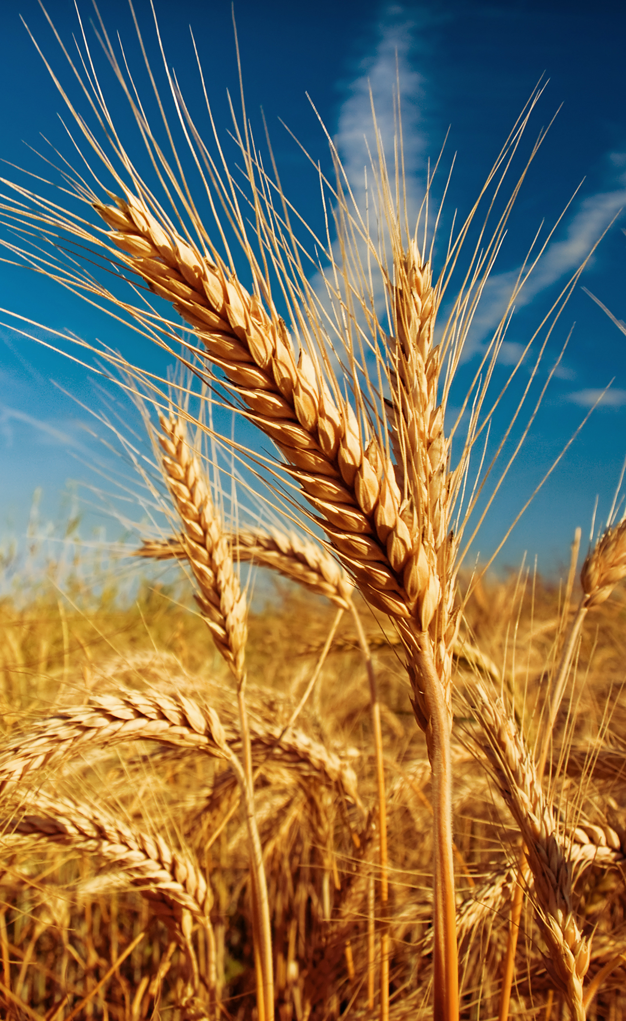
TOTAL MEMBER INVOLVEMENT
The number of MEMBERS
does not equal success.
The number of WORKERS
equals success.

Slide 5
CHURCH
PLANNER

Slide 6
STEPS FOR LOCAL CHURCHES
Review the Global TMI strategy
Create your 2024-2025 Disciple-Making Evangelism Plan
Secure church board approval and implement your plans

Slide 7
QUESTION
What if a church (or higher organization) already has plans for 2024-2025?
Notes:
That’s great! We expect that many divisions, unions, conferences, and local churches are already working on plans for 2024-2025. Global TMI is not itself a plan, but a framework that helps all our plans to be comprehensive, active, and ongoing. This framework includes three preliminary steps to revive and equip your church and five essential ministry areas for every phase of disciple-making. Lay out your existing plans using the blank planning form (downloadable here). You can use the sample church form as a helpful reference (downloadable here). Then, consider these questions:
Is there any preliminary step or essential ministry area that is either not present at all or not very active in your plans?
Is there any essential ministry area that consists only of activities and events, but no ongoing structure (leadership personnel, budget, resources, annual plans)?
Do your plans include holding evangelistic reaping meetings in either a traditional, seminar, or small group format in 2024-2025?
If the answer to the first two questions is no, and the answer to the third question is yes, then you are ready to participate in Global TMI! Praise the Lord! If not, you can use the Global TMI framework to enhance your plans to be even more effective, and to unite with your sister churches around the world in launching a global disciple-making strategy.

Slide 8
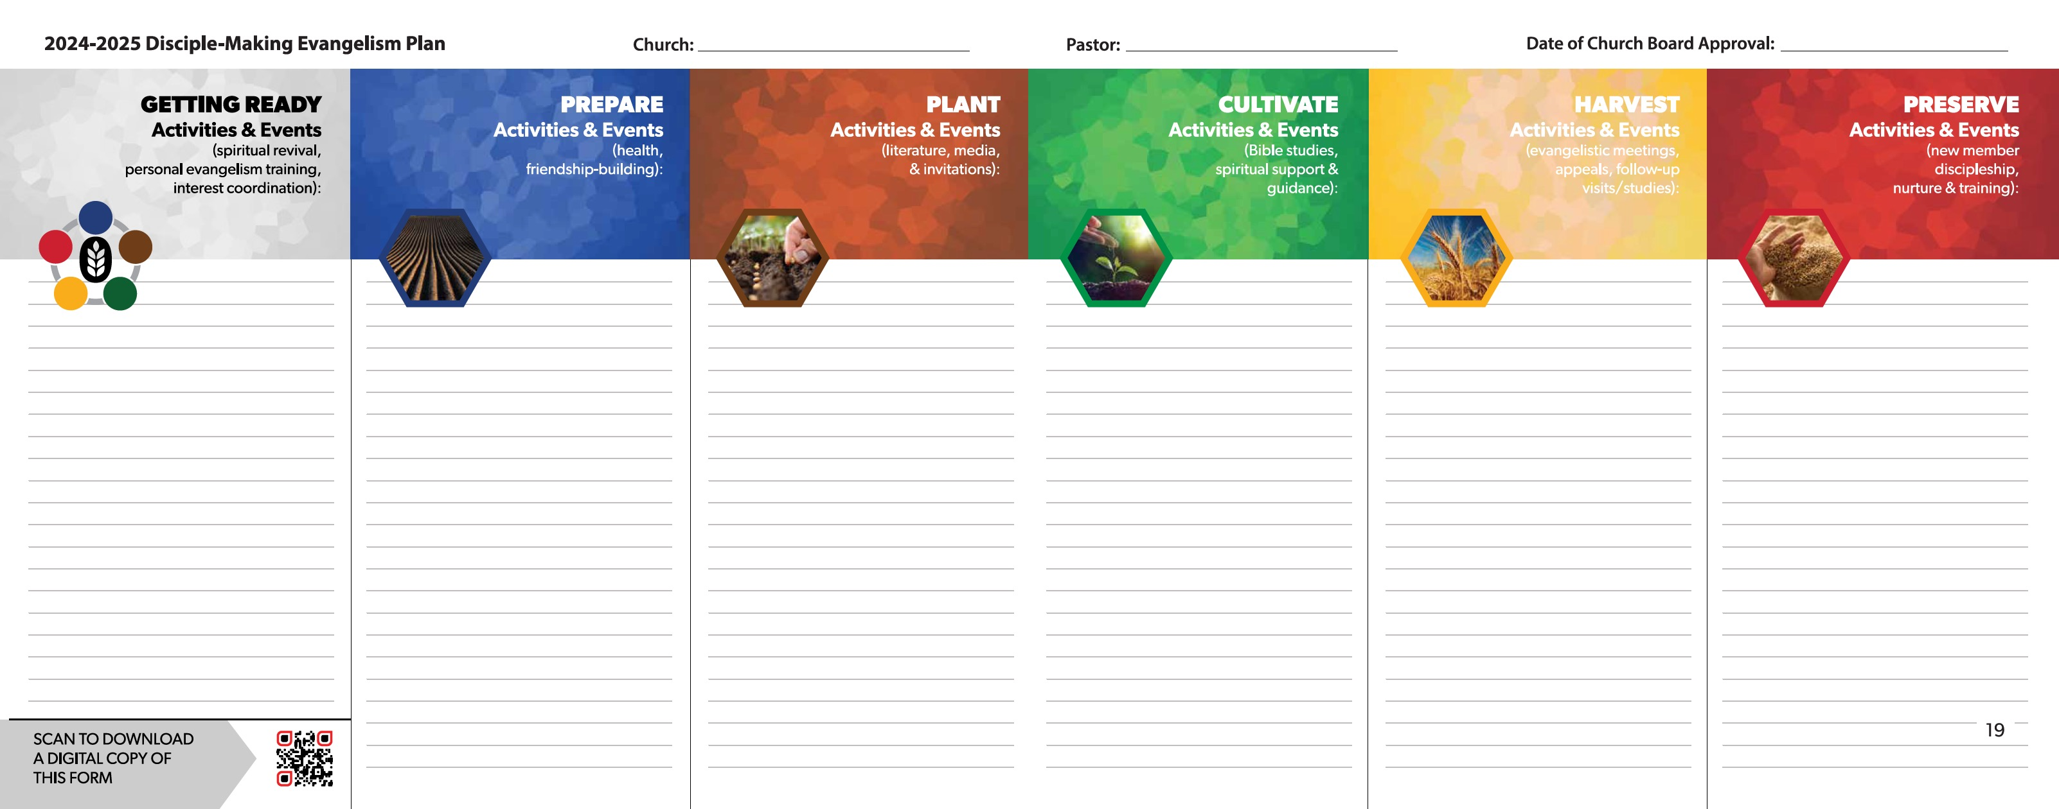
2024-2025 DISCIPLE-MAKING EVANGELISM
Blank Planning Form

Slide 9
QUESTION
How does Global TMI
help division, union, and conference administrators?
Notes:
Global TMI can help strengthen the evangelistic goals in your territory by providing an exciting worldwide initiative for your churches to unite behind. The strategy and resources can inspire local churches in your region to sharpen their evangelistic plans and improve retention rates. The Global TMI planning form also provides a framework that can be used by churches to report their evangelistic plans and results, and to better track disciple-making activity and measure growth.
The key elements of the Global TMI strategy can all be found in the Church Manual. But organizing them into one “active, ongoing discipleship plan” (p. 137) framework for local churches provides a helpful way for administrators to share their own initiatives in the same local context. For instance, “Comprehensive Health” or “Compassion” initiatives can be explained as aiding local churches in the essential PREPARE ministries of the Global TMI strategy. The “Missionary Book of the Year” can be promoted as a benefit to the local church’s essential PLANT ministries. “Nurture and Retention” initiatives can be promoted as valuable assets for each church’s essential PRESERVE ministries. The Global TMI disciple-making framework gives administrators a way to communicate initiatives so that local churches will see their benefit and importance, rather than viewing them as mere add-ons to their existing plans. Global TMI makes the initiatives and resources of the higher levels of the organization more relevant to local churches.

Slide 10
2024-2025 DISCIPLE-MAKING EVANGELISM
Sample Church Plan

Slide 11
STEPS FOR ADMINISTRATORS
Promote Global TMI through every platform possible—meetings of administrators, social media, publications, camp meetings, etc.

Slide 12
STEPS FOR ADMINISTRATORS
Supply the Global TMI Church Planner to every pastor
Ask every church to complete the Global TMI planning form
Report the number of participating churches in your territory
Notes:
In order for the Global TMI initiative to reach local churches and their members, it must be given strong communication and support at every level of the organization. Divisions, unions, and conferences are encouraged to utilize every platform possible to create awareness and promotion of Global TMI in their territories. Utilize meetings of administrators, church publications, social media channels, camp meetings, and more.
Perhaps most significantly, Global TMI must be communicated by leaders at the conference or mission level to every pastor around the world. The Global TMI Church Planner is a resource that can be printed by a local field in multiple languages and provided to every pastor. Then, by requesting that every church submit its plans to the local conference or mission, using the simple Global TMI Planning Form, we can gain the highest level of participation—with a goal of Total Member Involvement.
Imagine every church around the world, not only holding evangelistic reaping meetings, but also establishing ministries that meet needs, find spiritual interests, develop interests, and train new workers after baptism. Every division, union, and conference is encouraged to use their influence and means to involve as many churches as possible in Global TMI.

Slide 13
QUESTION
Are there resources available to help with evangelistic meetings in 2024-2025?
Notes:
Yes! If you have one or more pastors or church members willing to speak for an evangelistic reaping meeting, you may want to consider several series of sermons and presentation slides available on our resource page under Harvest resources.
You may also consider utilizing YouTube to stream a single speaker to numerous local churches and other venues throughout your territory. Pastor Mark Finley recently conducted a successful effort using YouTube in China, where there have been over 10 million downloads of his messages.
Another very good option is a new series of 18 presentations by Pastor Doug Batchelor of Amazing Facts entitled, Prophecy Odyssey. This series will be streamed from New York City September 20 to October 5, 2024. Wherever you are in the world, you can hold meetings in homes, churches, or other venues to view Pastor Batchelor’s messages in one of five major languages. They can be viewed live or on time delay, and there will be new lessons, handbills, and artwork available for free download. Go to prophecyodyssey.com for more information.

