Slide 1
Ressources available
TOUT MEMBRE IMPLIQUÉ

Slide 2
8.1 Milliards
TOUT MEMBRE IMPLIQUÉ

Slide 3
QUESTION
Des ressources sont-elles disponibles pour les réunions d'évangélisation en 2024-2025 ?
Notes:
Yes! If you have one or more pastors or church members willing to speak for an evangelistic reaping meeting, you may want to consider several series of sermons and presentation slides available on our resource page under Harvest resources.
You may also consider utilizing YouTube to stream a single speaker to numerous local churches and other venues throughout your territory. Pastor Mark Finley recently conducted a successful effort using YouTube in China, where there have been over 10 million downloads of his messages.
Another very good option is a new series of 18 presentations by Pastor Doug Batchelor of Amazing Facts entitled, Prophecy Odyssey. This series will be streamed from New York City September 20 to October 5, 2024. Wherever you are in the world, you can hold meetings in homes, churches, or other venues to view Pastor Batchelor’s messages in one of five major languages. They can be viewed live or on time delay, and there will be new lessons, handbills, and artwork available for free download. Go to prophecyodyssey.com for more information.

Slide 4
QUESTION
Y a-t-il d'autres ressources disponibles pour aider les ministères essentiels de formation de disciples ?
Notes:
Yes! Please review the Resources page for helpful materials from nearly every department of the church. There you can find many sharing and training materials, including those made especially for families, women, youth, and children. You can also find the following resources designed specifically to aid local churches in the preliminary steps and essential disciple-making ministry areas outlined in the Global TMI strategy:
Back to the Altar—a website with discipleship resources focused specifically on spiritual revival.
Spread the Word—a training resource on witnessing and personal evangelism designed for local church members and leaders; including a section on spiritual revival as well as how to run local church literature, media, and invitation ministries.
Fundamentals of Faith—a simple guide to be used in leading individuals to decisions for Christ (harvest) as they review the fundamental teachings of the Bible in preparation for baptism.
Discipleship Handbook—this book provides a simple and comprehensive way for local churches to nurture and train newly baptized members and integrate them into the life and mission of the church.
Check out these and many more valuable tools on the Resources page!

Slide 5
QUESTION
Y a-t-il d'autres ressources disponibles pour aider les ministères essentiels de formation de disciples ?
Notes:
Yes! Please review the Resources page for helpful materials from nearly every department of the church. There you can find many sharing and training materials, including those made especially for families, women, youth, and children. You can also find the following resources designed specifically to aid local churches in the preliminary steps and essential disciple-making ministry areas outlined in the Global TMI strategy:
Back to the Altar—a website with discipleship resources focused specifically on spiritual revival.
Spread the Word—a training resource on witnessing and personal evangelism designed for local church members and leaders; including a section on spiritual revival as well as how to run local church literature, media, and invitation ministries.
Fundamentals of Faith—a simple guide to be used in leading individuals to decisions for Christ (harvest) as they review the fundamental teachings of the Bible in preparation for baptism.
Discipleship Handbook—this book provides a simple and comprehensive way for local churches to nurture and train newly baptized members and integrate them into the life and mission of the church.
Check out these and many more valuable tools on the Resources page!

Slide 6
ÉGLISES ET GROUPES
(en date du décembre 31, 2022)
Églises
19,240
965
15,816
2,510
5,712
860
15,345
2,338
13,908
Groupes
13,223
608
8,501
540
904
212
14,134
4,238
14,175
Division Africaine Orientale et Centrale
Division Euro-Asiatique
Division Inter-Américaine
Division Inter-Européene
Division Amérique du Nord
Division Asie-Pacifique Nord
Division Amérique du Sud
Division Pacifique du Sud
Division Afrique Australe-Océan Indien

Slide 7
ÉGLISES ET GROUPES
(en date du décembre 31, 2022)
Églises
4,594
8,235
1,182
5,156
1,135
62
738
15
97,811
Groupes
4,807
3,789
217
5,449
2,864
26
194
5
73,886
Division Asie du Sud
Division Asie-Pacifique Sud
Division Transeuropéene
Division Afrique Occidentale et Centrale
Mission de l’Union chinoise
Mission de l’Union du Moyen-Orient et de l’Afrique du Nord
Conférence de l’Union ukrainienne
Champ d’Israel
Total

Slide 8
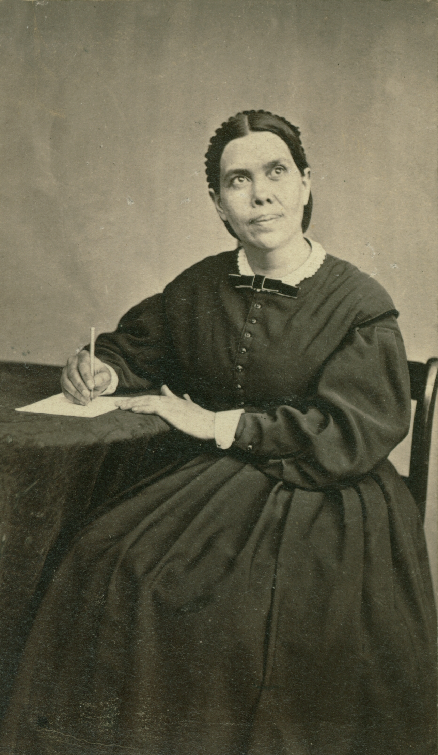
WAUKON, IOWA

Slide 9
WAUKON, IOWA
Que fais-tu ici, Élie?

Slide 11
“« Nous n'avons pas de temps à perdre. La fin est proche. Le passage d'un lieu à l'autre pour répandre la vérité sera bientôt entouré de dangers à droite et à gauche. Tout sera mis en place pour obstruer le chemin des messagers du Seigneur,

Slide 12
“afin qu'ils ne puissent pas faire ce qu’il leur est possible de faire maintenant. Nous devons regarder notre travail en face et avancer aussi vite que possible dans une guerre agressive.’’
Evangélisation, p. 30

Slide 13
8.1 Milliards

Slide 14
8.1 Milliards
TOUT MEMBRE IMPLIQUÉ

