Slide 2
A Biblical Strategy for Disciple-Making Evangelism

Slide 3
“The real character of the church is measured, not by the high profession she makes, not by the names enrolled on her books, but by what she is actually doing for the Master, by the number of her persevering, faithful workers.”
Gospel Workers, p. 200

Slide 4
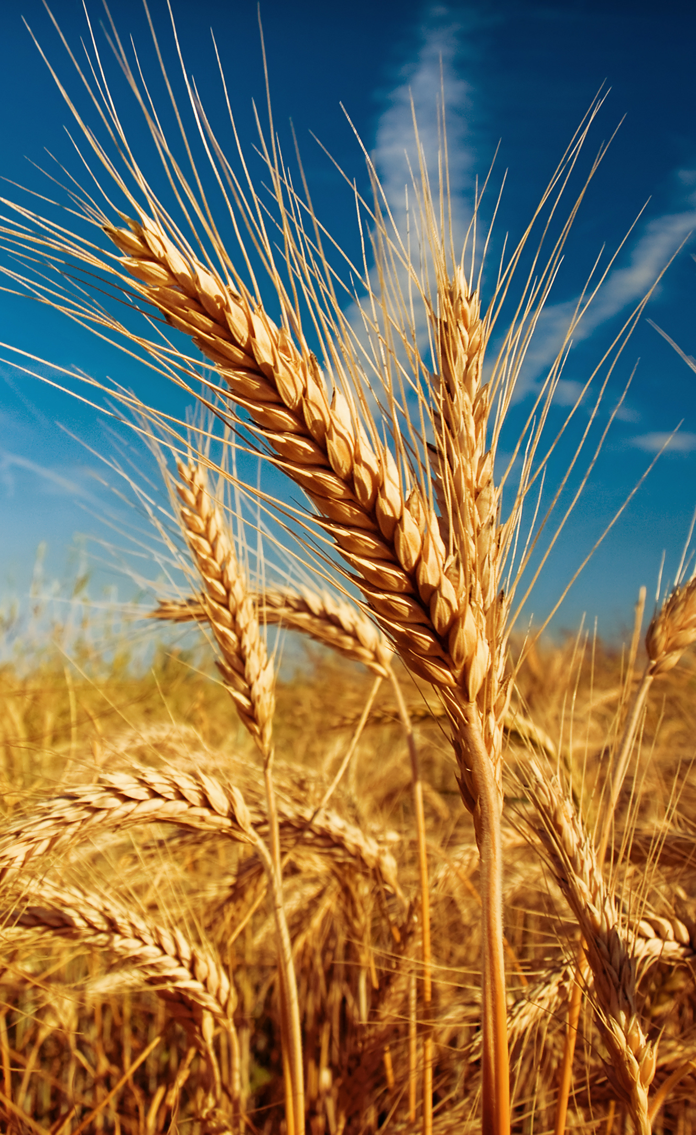
TOTAL MEMBER INVOLVEMENT
The number of MEMBERS
does not equal success.
The number of WORKERS
equals success.

Slide 5
CHURCH
PLANNER

Slide 6
ACTIVE AND ONGOING
Church Manual, p. 137
Leadership personnel
Budget
Resources
Annual Plan

Slide 7
ACTIVE & ONGOING (Church Manual, p. 137)
PREPARE
PLANT
CULTIVATE
HARVEST
PRESERVE

Slide 8
ACTIVE & ONGOING (Church Manual, p. 137)
PREPARE
PLANT
CULTIVATE
HARVEST
PRESERVE
Health Ministries Leader
(p. 100)
Community Services Leader
(p. 107)

Slide 9
ACTIVE & ONGOING (Church Manual, p. 137)
PREPARE
PLANT
CULTIVATE
HARVEST
PRESERVE
Health Ministries Leader
(p. 100)
Community Services Leader
(p. 107)
Publishing Ministries Coordinator
(p. 102)
Personal Ministries Assistant
(p. 107)

Slide 10
ACTIVE & ONGOING (Church Manual, p. 137)
PREPARE
PLANT
CULTIVATE
HARVEST
PRESERVE
Health Ministries Leader
(p. 100)
Community Services Leader
(p. 107)
Publishing Ministries Coordinator
(p. 102)
Personal Ministries Assistant
(p. 107)
Bible
School Coordinator
(p. 107)
Interest
Coordinator
(p. 107)

Slide 11
ACTIVE & ONGOING (Church Manual, p. 137)
PREPARE
PLANT
CULTIVATE
HARVEST
PRESERVE
Health Ministries Leader
(p. 100)
Community Services Leader
(p. 107)
Publishing Ministries Coordinator
(p. 102)
Personal Ministries Assistant
(p. 107)
Bible
School Coordinator
(p. 107)
Interest
Coordinator
(p. 107)
Pastor and Church Board
(p. 138)
Personal Ministries Leader
(p. 107)

Slide 12
ACTIVE & ONGOING (Church Manual, p. 137)
PREPARE
PLANT
CULTIVATE
HARVEST
PRESERVE
Health Ministries Leader
(p. 100)
Community Services Leader
(p. 107)
Publishing Ministries Coordinator
(p. 102)
Personal Ministries Assistant
(p. 107)
Bible
School Coordinator
(p. 107)
Interest
Coordinator
(p. 107)
Pastor and Church Board
(p. 138)
Personal Ministries Leader
(p. 107)
Personal Ministries Leader
(pp. 106-107)
Personal Ministries Assistant
(p. 107)

Slide 13
ACTIVE & ONGOING (Church Manual, p. 137)
PREPARE
PLANT
CULTIVATE
HARVEST
PRESERVE
Health Ministries Leader
(p. 100)
Community Services Leader
(p. 107)
Publishing Ministries Coordinator
(p. 102)
Personal Ministries Assistant
(p. 107)
Bible
School Coordinator
(p. 107)
Interest
Coordinator
(p. 107)
Pastor and Church Board
(p. 138)
Personal Ministries Leader
(p. 107)
Personal Ministries Leader
(pp. 106-107)
Personal Ministries Assistant
(p. 107)
Leaders in Family, Women’s, Men’s, Youth, Children’s, Club, Sabbath School, Religious Liberty, Possibility, Communication, Stewardship, and Education/School Ministries (pp. 136-137)

Slide 14
ACTIVE & ONGOING (Church Manual, p. 137)
PREPARE
PLANT
CULTIVATE
HARVEST
PRESERVE
Health Ministries Leader
(p. 100)
Community Services Leader
(p. 107)
Publishing Ministries Coordinator
(p. 102)
Personal Ministries Assistant
(p. 107)
Bible
School Coordinator
(p. 107)
Interest
Coordinator
(p. 107)
Pastor and Church Board
(p. 138)
Personal Ministries Leader
(p. 107)
Personal Ministries Leader
(pp. 106-107)
Personal Ministries Assistant
(p. 107)
Leaders in Family, Women’s, Men’s, Youth, Children’s, Club, Sabbath School, Religious Liberty, Possibility, Communication, Stewardship, and Education/School Ministries (pp. 136-137)

Slide 15
ACTIVE & ONGOING (Church Manual, p. 137)
PREPARE
PLANT
CULTIVATE
HARVEST
PRESERVE
Health Ministries Leader
(p. 100)
Community Services Leader
(p. 107)
Publishing Ministries Coordinator
(p. 102)
Personal Ministries Assistant
(p. 107)
Bible
School Coordinator
(p. 107)
Interest
Coordinator
(p. 107)
Pastor and Church Board
(p. 138)
Personal Ministries Leader
(p. 107)
Personal Ministries Leader
(pp. 106-107)
Personal Ministries Assistant
(p. 107)
Leaders in Family, Women’s, Men’s, Youth, Children’s, Club, Sabbath School, Religious Liberty, Possibility, Communication, Stewardship, and Education/School Ministries (pp. 136-137)

Slide 16
ACTIVE & ONGOING (Church Manual, p. 137)
PREPARE
PLANT
CULTIVATE
HARVEST
PRESERVE
Health Ministries Leader
(p. 100)
Community Services Leader
(p. 107)
Publishing Ministries Coordinator
(p. 102)
Personal Ministries Assistant
(p. 107)
Bible
School Coordinator
(p. 107)
Interest
Coordinator
(p. 107)
Pastor and Church Board
(p. 138)
Personal Ministries Leader
(p. 107)
Personal Ministries Leader
(pp. 106-107)
Personal Ministries Assistant
(p. 107)
Leaders in Family, Women’s, Men’s, Youth, Children’s, Club, Sabbath School, Religious Liberty, Possibility, Communication, Stewardship, and Education/School Ministries (pp. 136-137)

Slide 17
ACTIVE & ONGOING (Church Manual, p. 137)
PREPARE
PLANT
CULTIVATE
HARVEST
PRESERVE
Health Ministries Leader
(p. 100)
Community Services Leader
(p. 107)
Publishing Ministries Coordinator
(p. 102)
Personal Ministries Assistant
(p. 107)
Bible
School Coordinator
(p. 107)
Interest
Coordinator
(p. 107)
Pastor and Church Board
(p. 138)
Personal Ministries Leader
(p. 107)
Personal Ministries Leader
(pp. 106-107)
Personal Ministries Assistant
(p. 107)
Leaders in Family, Women’s, Men’s, Youth, Children’s, Club, Sabbath School, Religious Liberty, Possibility, Communication, Stewardship, and Education/School Ministries (pp. 136-137)

Slide 18
ACTIVE & ONGOING (Church Manual, p. 137)
PREPARE
PLANT
CULTIVATE
HARVEST
PRESERVE
Health Ministries Leader
(p. 100)
Community Services Leader
(p. 107)
Publishing Ministries Coordinator
(p. 102)
Personal Ministries Assistant
(p. 107)
Bible
School Coordinator
(p. 107)
Interest
Coordinator
(p. 107)
Pastor and Church Board
(p. 138)
Personal Ministries Leader
(p. 107)
Personal Ministries Leader
(pp. 106-107)
Personal Ministries Assistant
(p. 107)
Leaders in Family, Women’s, Men’s, Youth, Children’s, Club, Sabbath School, Religious Liberty, Possibility, Communication, Stewardship, and Education/School Ministries (pp. 136-137)

Slide 19
CHURCH
PLANNER

